Slide 1

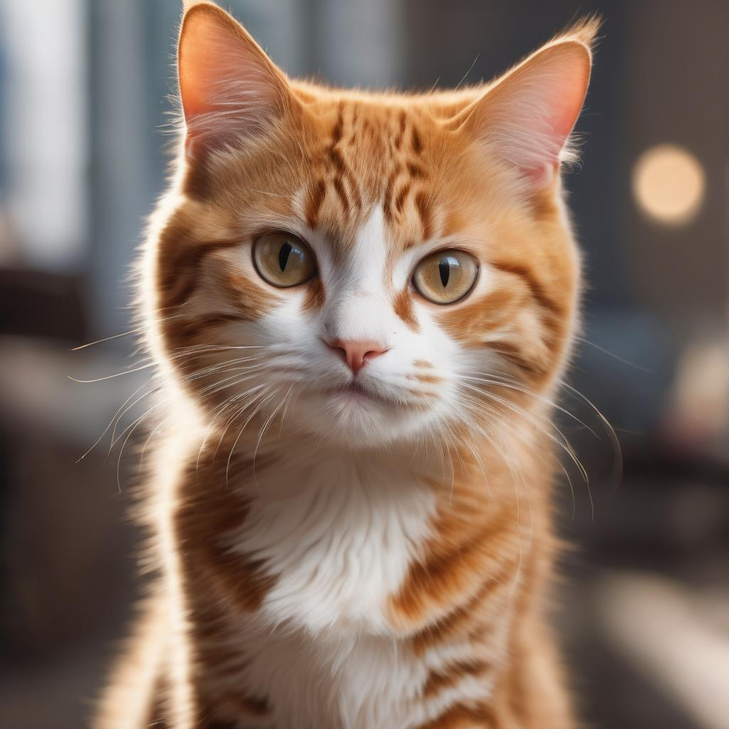
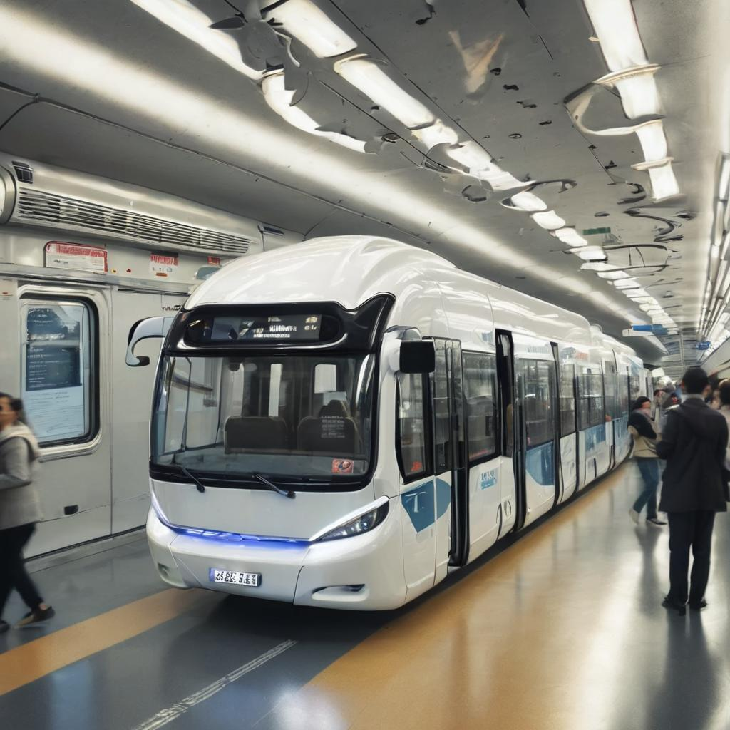
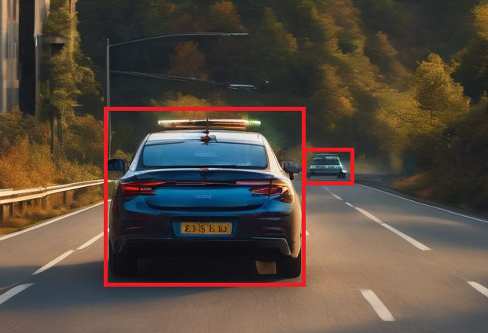
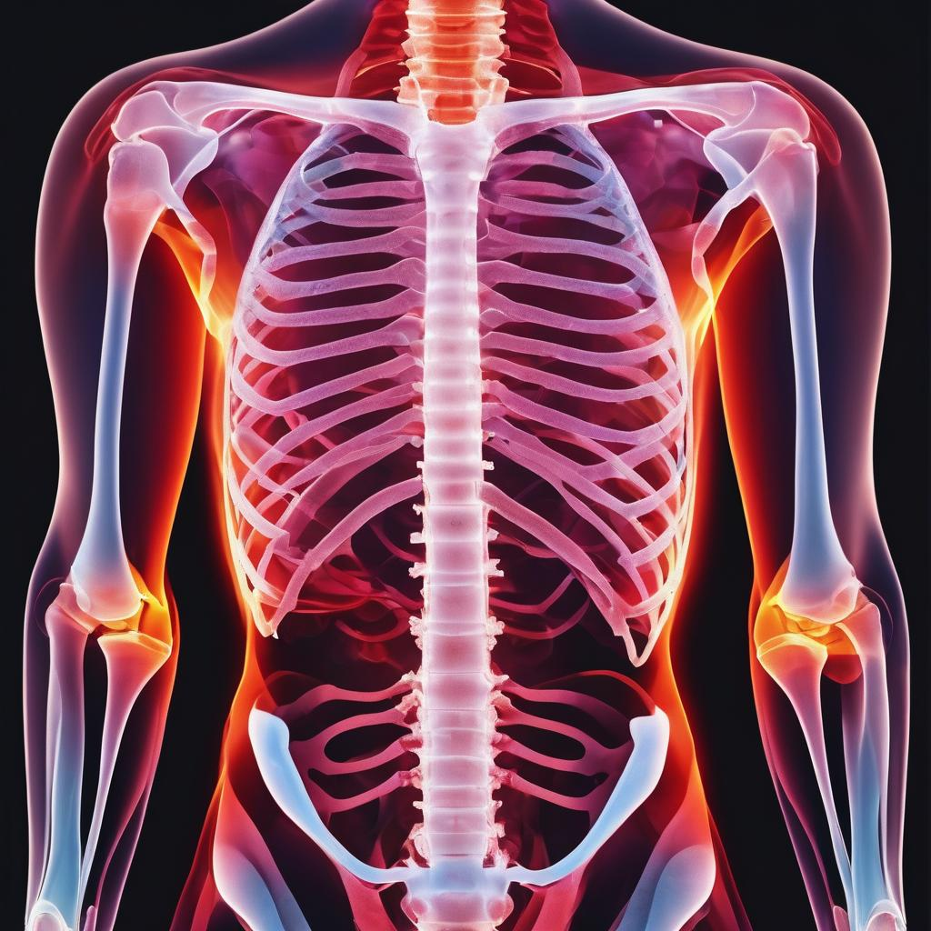
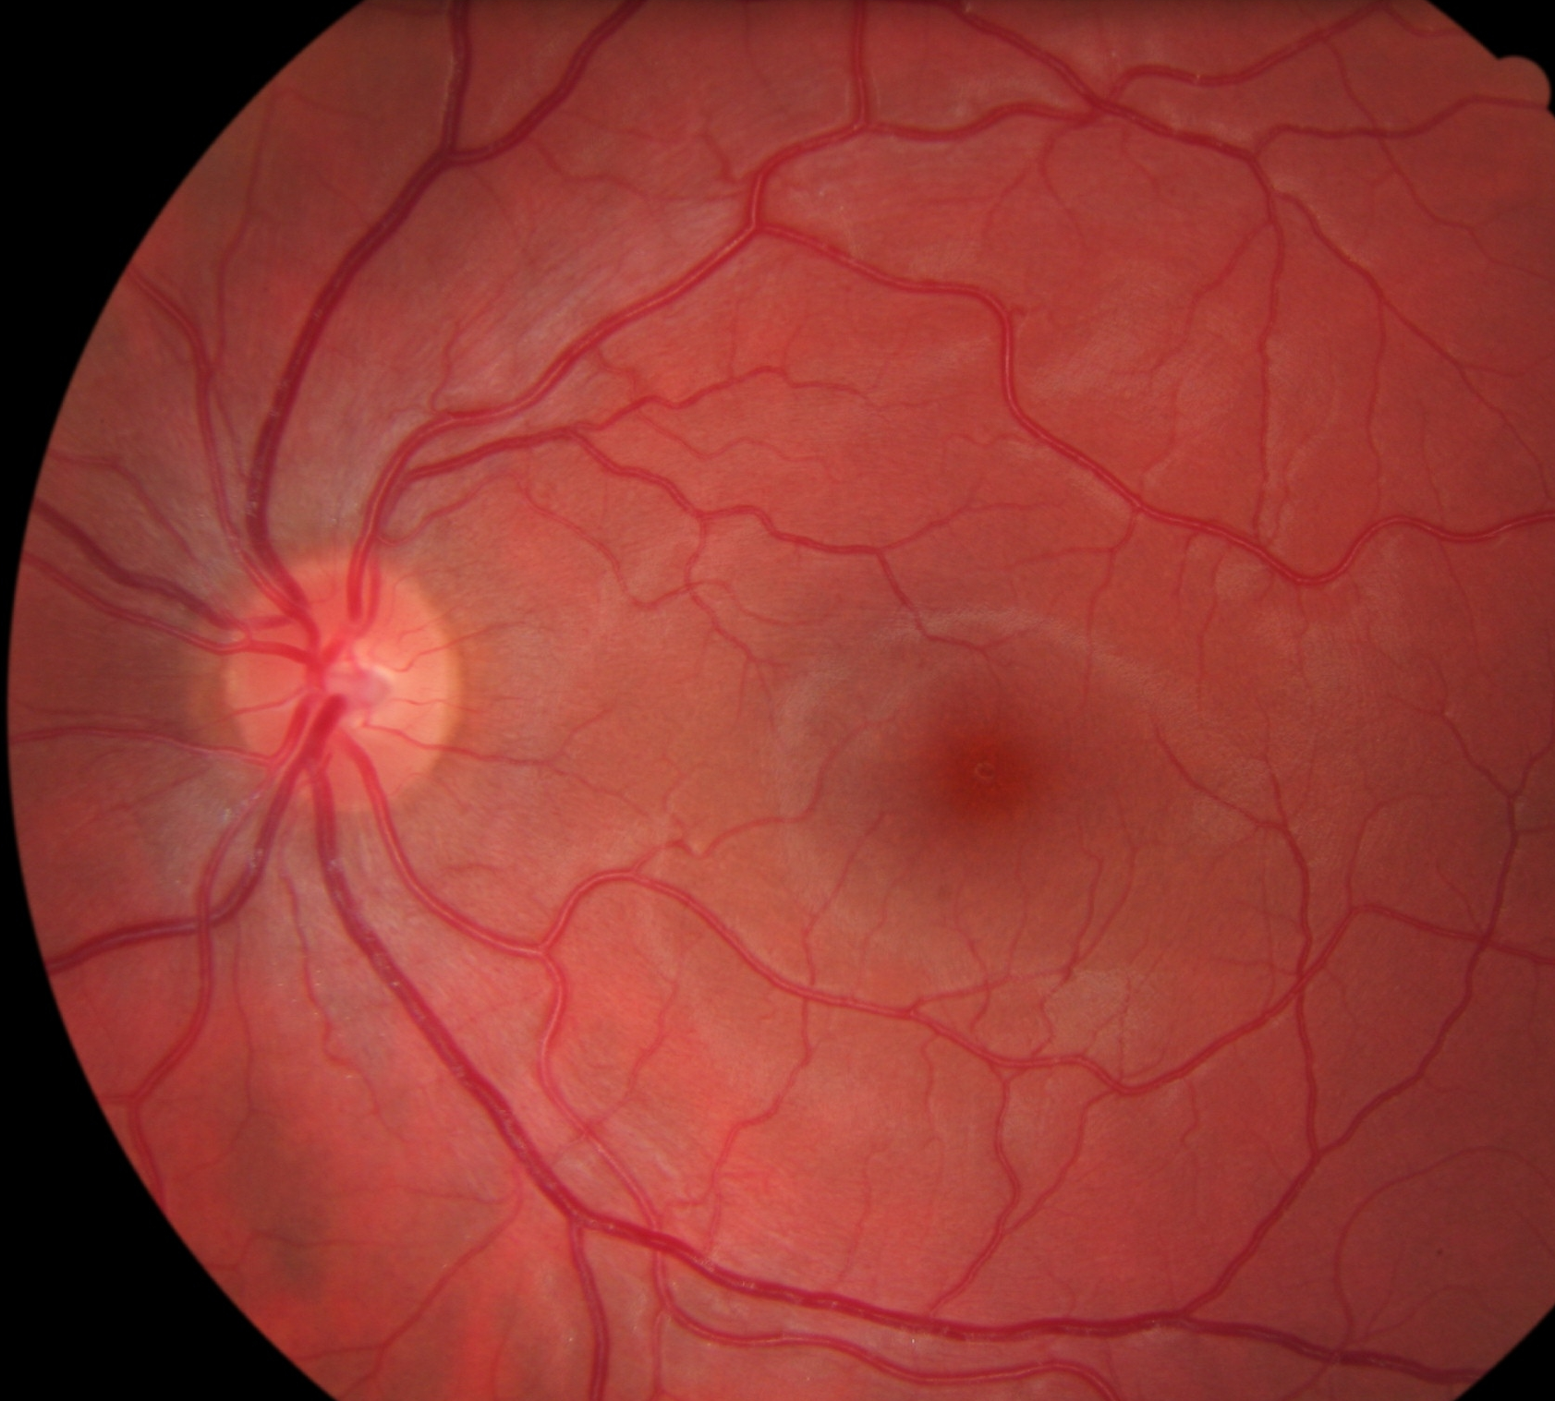
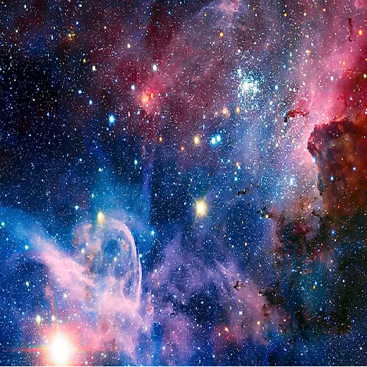
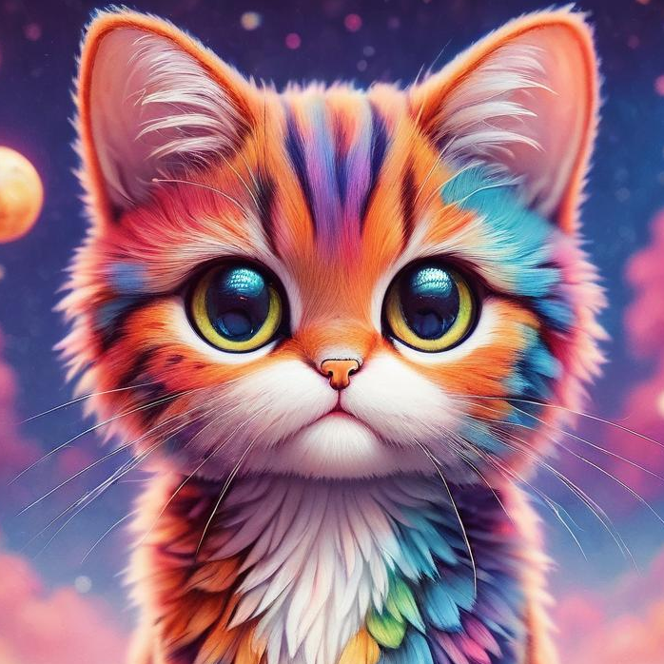
CNN: Common Use Cases
Image Classification
Object Detection
Neural Style Transfer
Cat?
5. Autonomous Transport
6. Healthcare
+ →
Celestial style cat

Slide 2
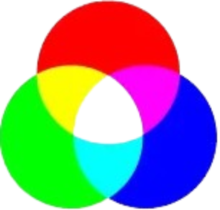
Additive Color Mixing
Images made up of pixels
8K
7680 px
4320 px
4K
(Ultra HD)
3840 px
2160 px
2K
(Quad HD) 2560 X 1440
Full HD
1920 X 1080
HD
1280 X 720
SD
640 X 480

Slide 3
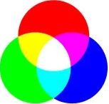
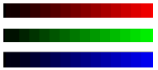
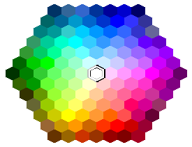
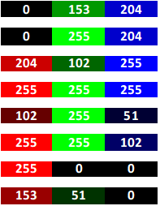
Additive Color Mixing
Every pixel has 1 byte for Red, Green & Blue each (R, G, B)
Each byte of R, G & B can have values 0 to 255 (Hex: 00 to ff)
Binary: 0000 0000 to 1111 1111
2⁸ – 1 = 255
Some mixes of R, G & B
0
255

Slide 4
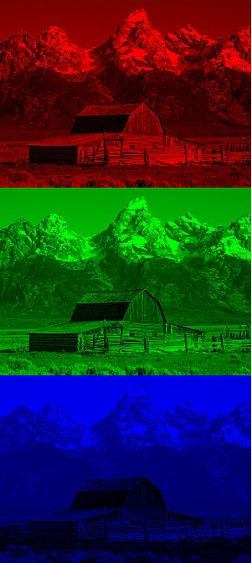
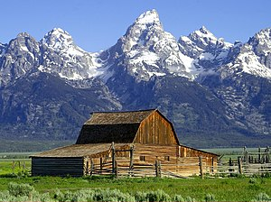
Colored Images
Superimposition of 3 separate images in:
Red
Green
Blue

